Slide 1

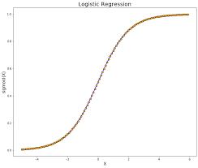
Machine Learning
Logistic Regression

Slide 2
What is Logistic Regression?
Logistic regression is basically a supervised classification algorithm.
Regression and classification are categorized under the same umbrella of supervised machine learning.
Logistic regression becomes a classification technique only when a decision threshold is brought into the picture.

Slide 3
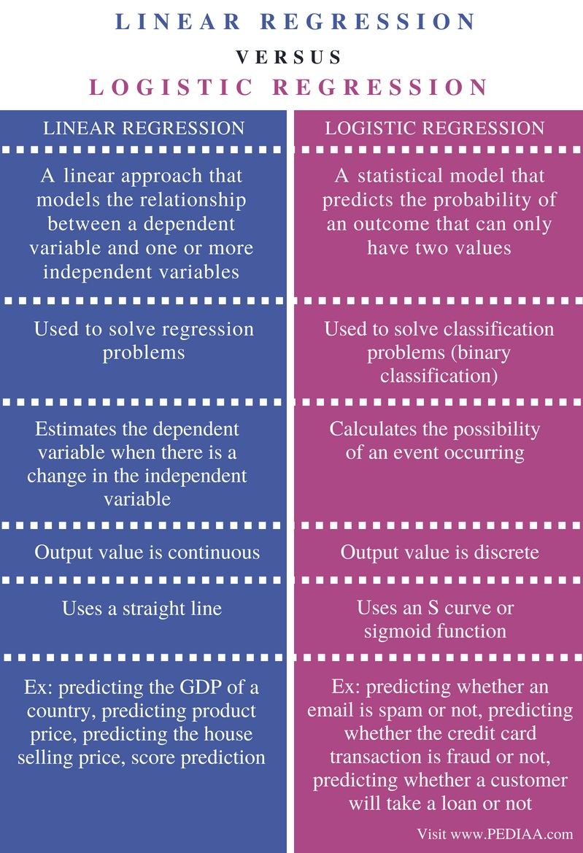
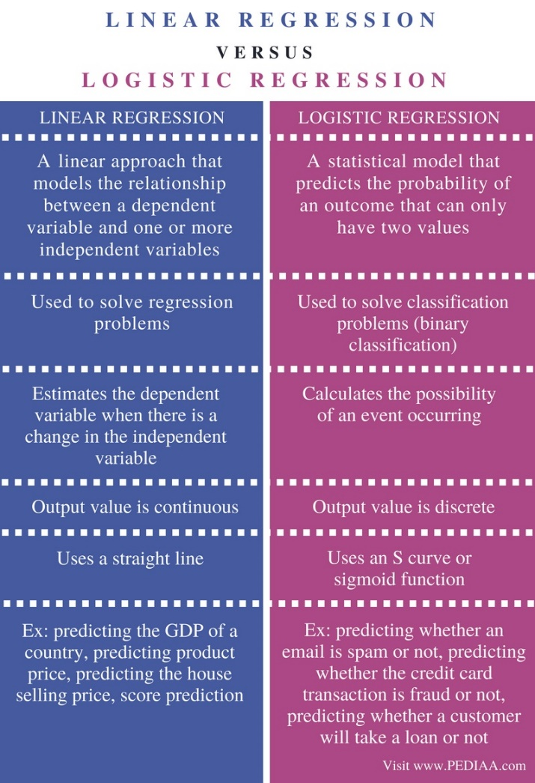
Linear Regression Vs Logistic Regression

Slide 4
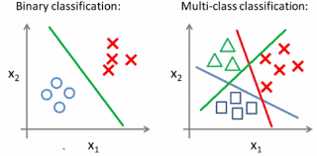
Classification
Two types
Two Class Classification/Binary Classification :
takes two values 0 or 1
Examples
Spam or Not Spam
Cancer Malignant or Benign
Rain Yes or No
Admission Yes or No
Multi Class Classification Problem :
takes more than 2 values
Examples
Identifying Digits
Identifying some images
Identifying some categories

Slide 5
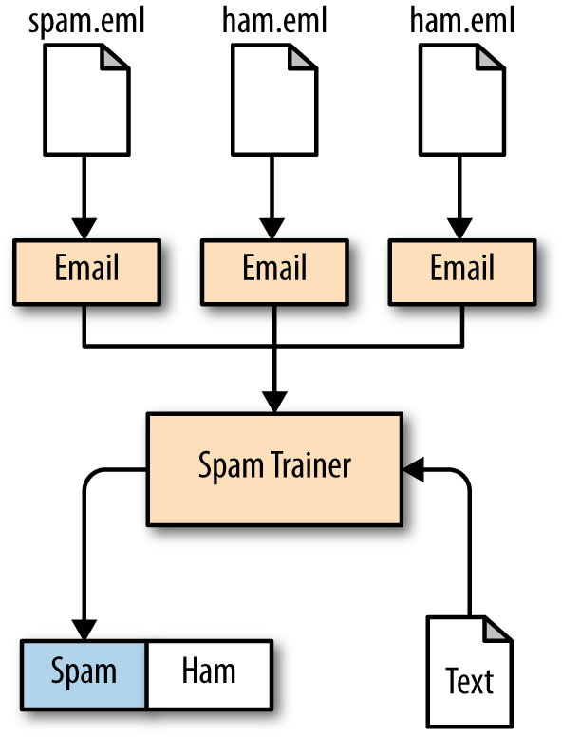
Classification
The variable to be predicted, will take two values either 1 or 0
1 Positive Class
0 Negative Class
Example
For instance, if we are trying to build a spam classifier for email, then x^i may be some features of a piece of email, and y may be 1 if it is a piece of spam mail, and 0 otherwise.

Slide 6
Classification Problem
The classification problem is just like the regression problem, except that the values we now want to predict take on only a small number of discrete values.
To attempt classification, one method is to use linear regression and map all predictions greater than 0.5 as a 1 and all less than 0.5 as a 0.
However, this method doesn't work well because classification is not actually a linear function.
Lets see why?

Slide 7
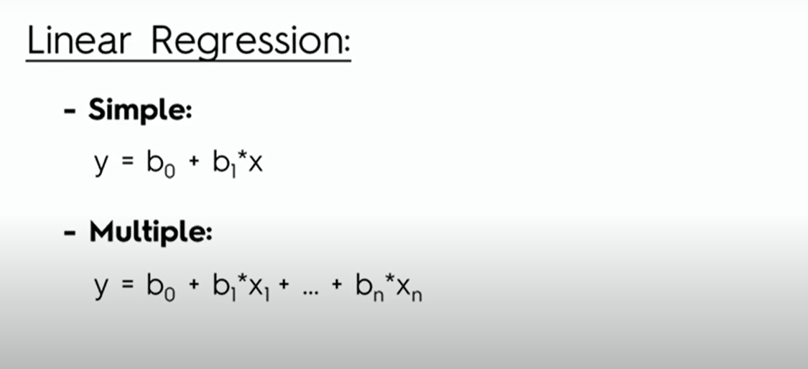
Linear Regression Equations with one independent variable and many independent variables

Slide 8
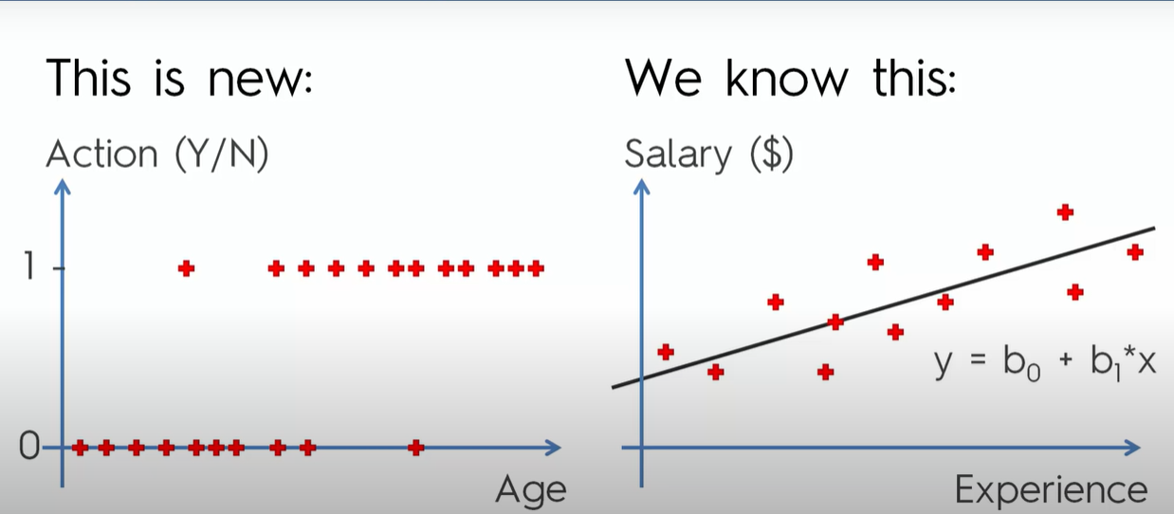
Logistic Regression 0 Means No 1 Means Yes

Slide 9
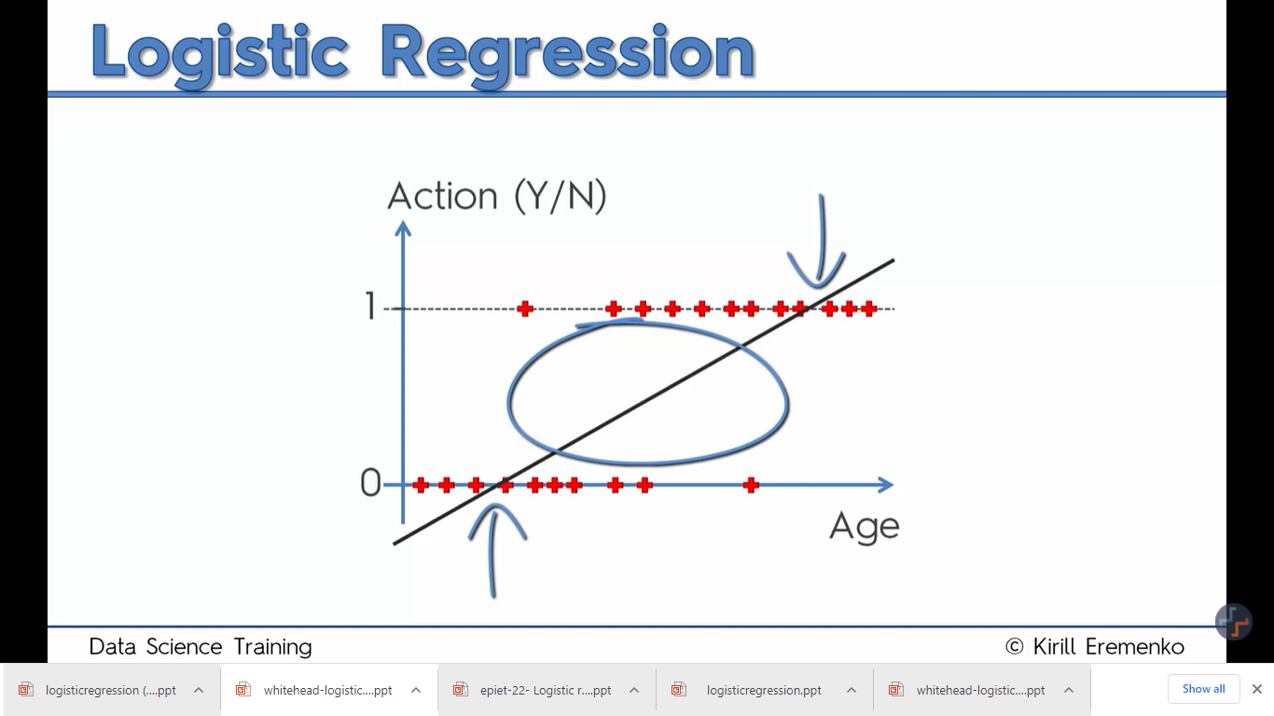
Instead of prediction, we state the probability of the likelihood of the person taking up the offer
Logistic Regression
Age between 25 and lets ay 55, there is probability of taking the offer and increases as we move right.
The points below the 0 line and above line 1 make no sense becoz probability can never be in this range.

Slide 10
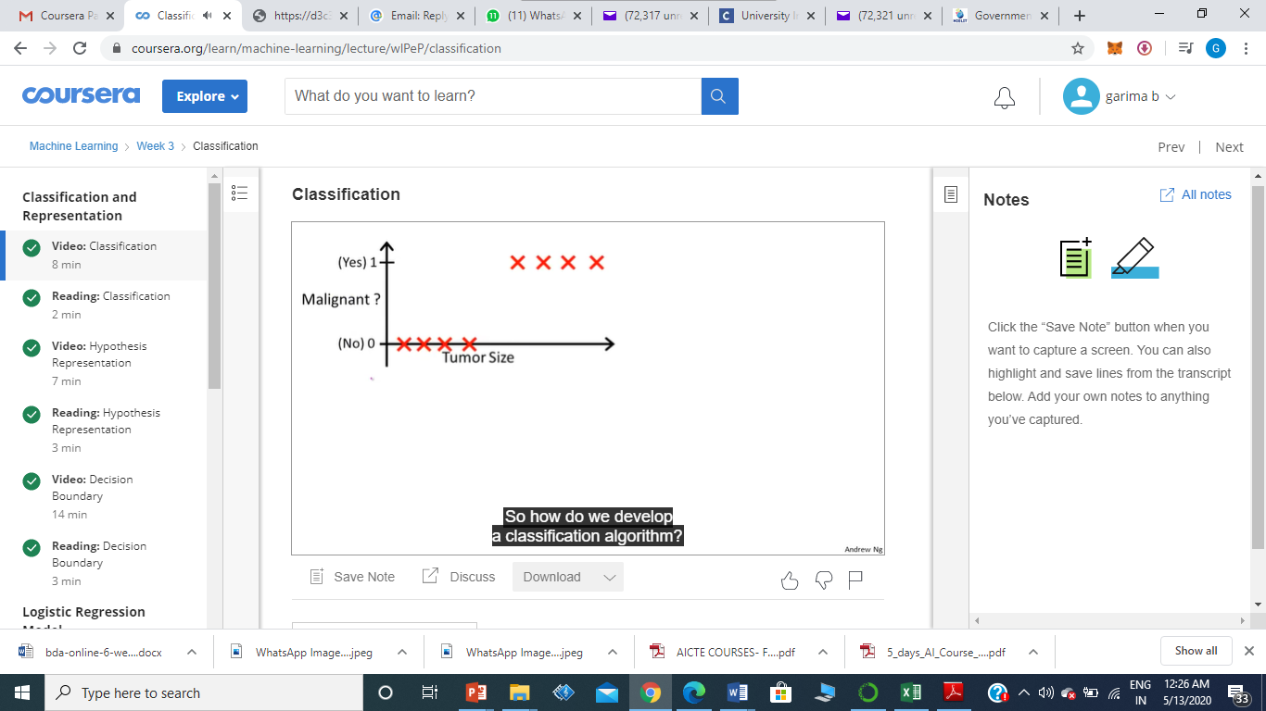
Classification Problem
Malignancy takes only two values 0 or 1

Slide 11
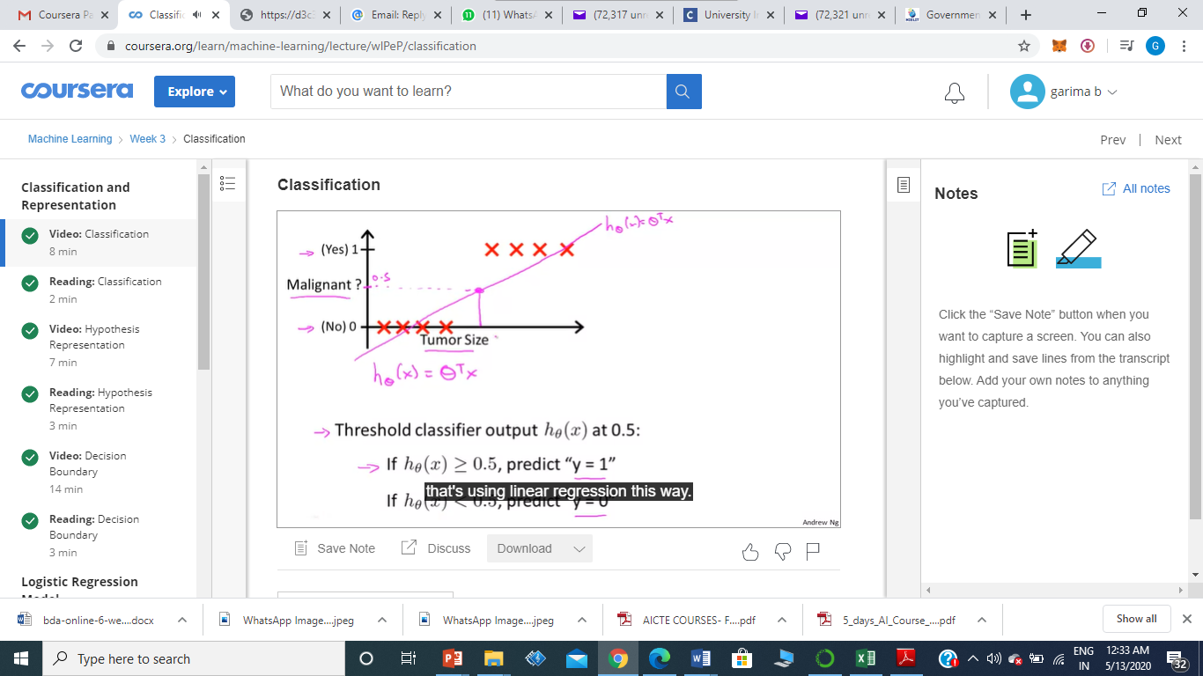
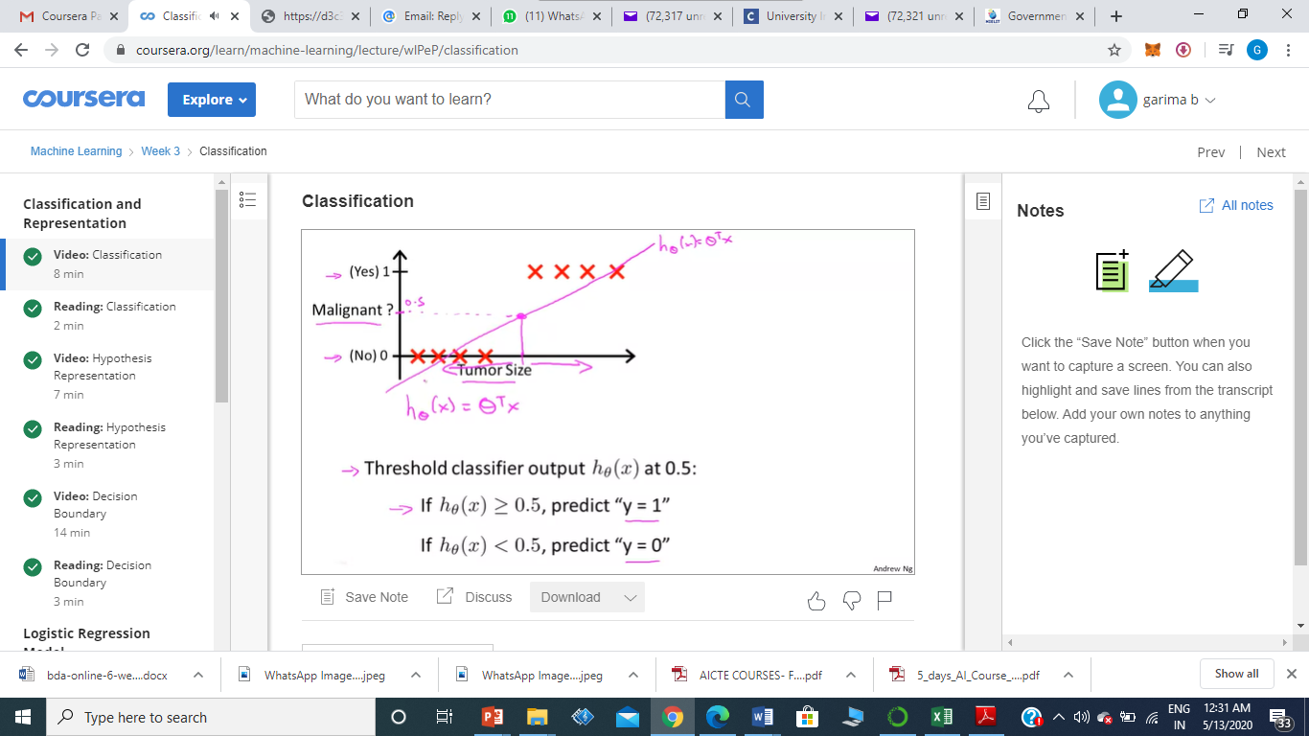
Applying Linear Regression
If we apply linear regression to this problem, and fit straight line to the data, we may get a hypothesis like this.

Slide 12
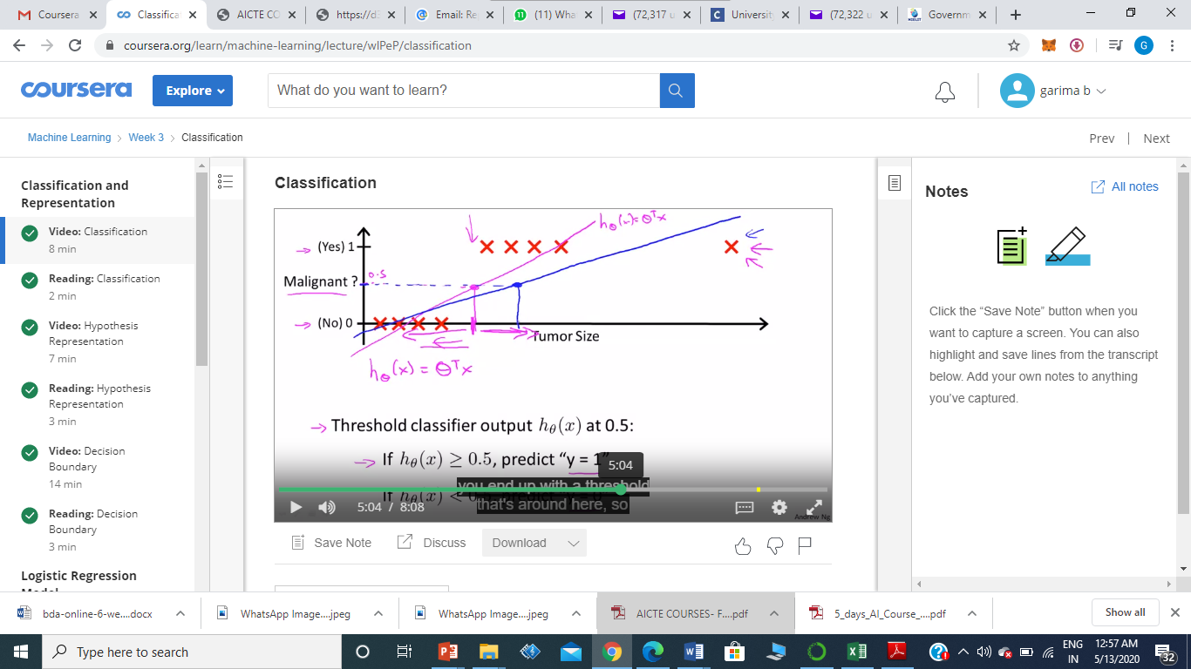
Applying Linear Regression
But when we have one more example, Linear regression line changes, and observe the dividing line. Now this hypothesis is unfit and not correct.
Therefore linear regression cannot be applied to classification problems.

Slide 13
Applying Linear Regression
Therefore Linear regression is not suitable for Classification Problem.
Another problem of applying Linear Regression hypothesis is that it may give answer > 1 or < 0 which is not required in classification problem.

Slide 14
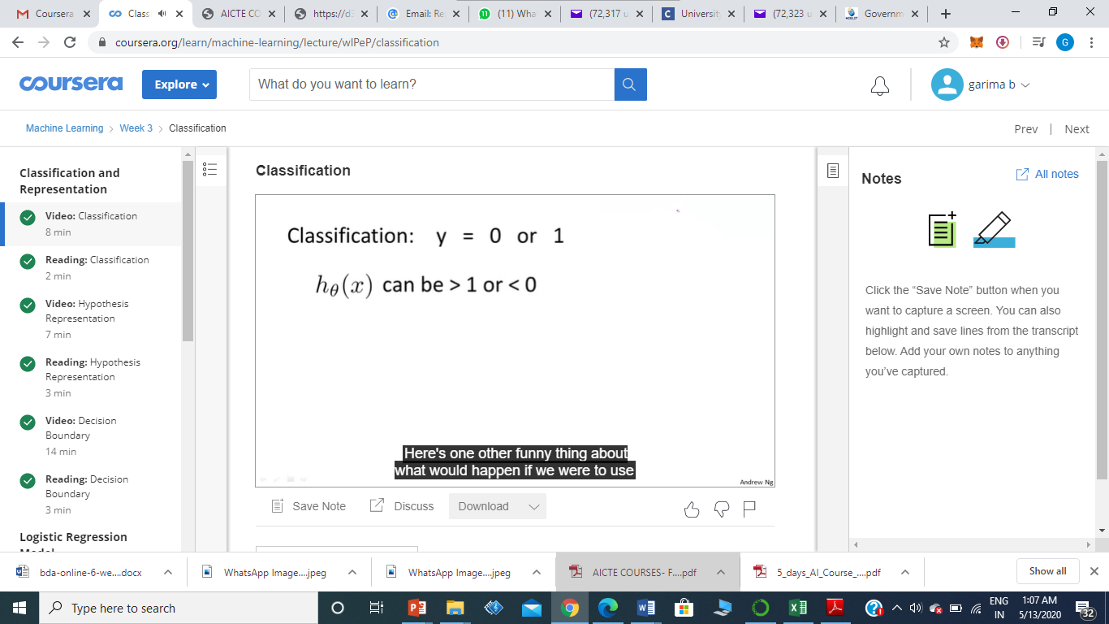
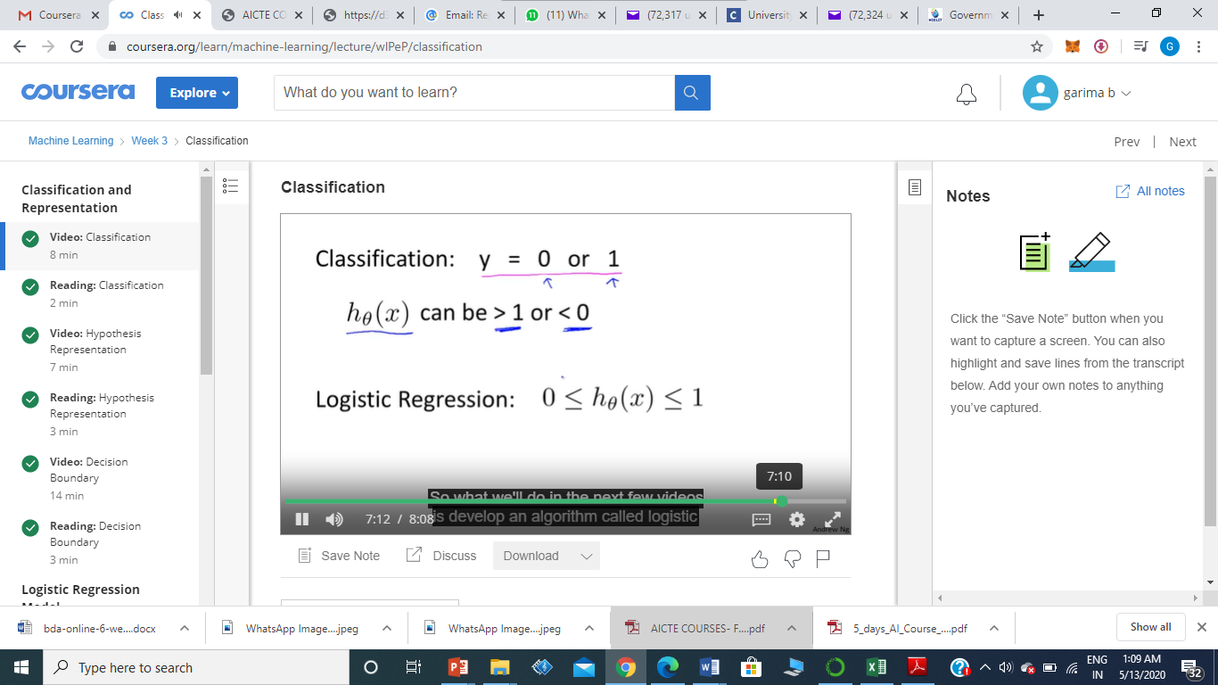
Logistic Regression
Logistic Regression is the algorithm having the property that its predictions are always between 0 and 1.

Slide 15
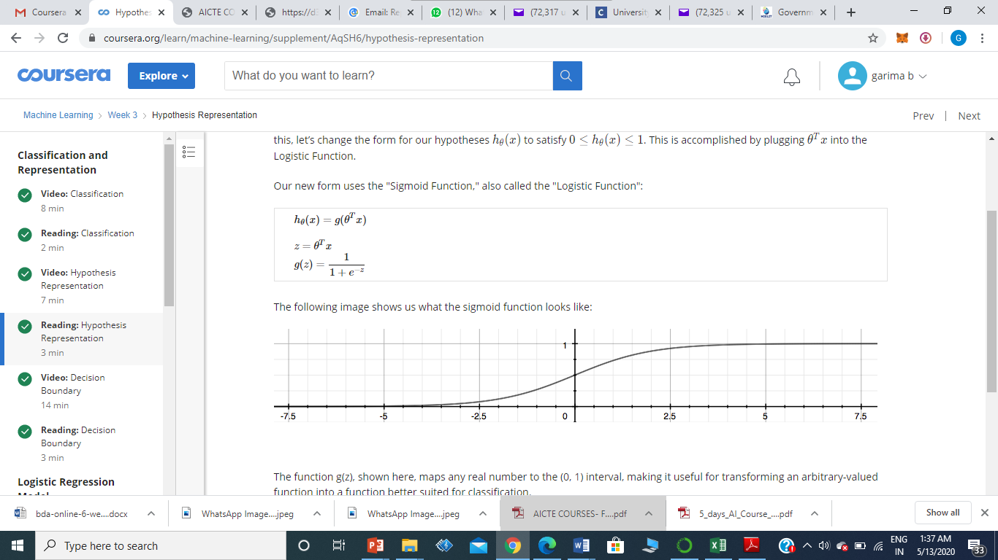
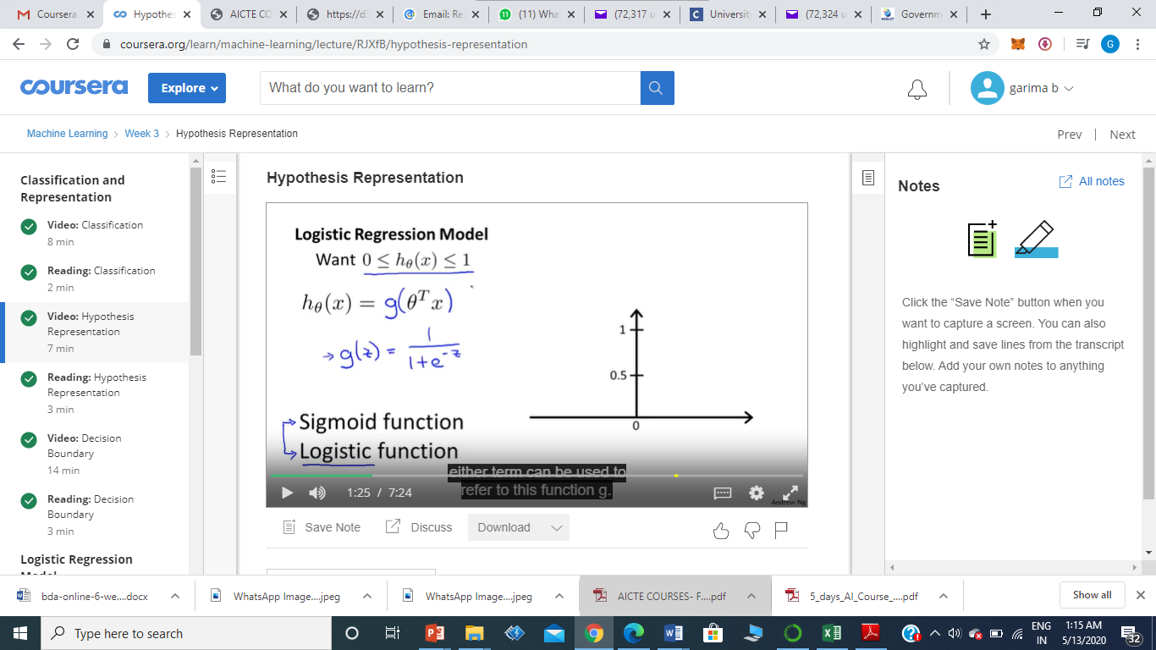
Logistic Function / Sigmoid Function
The function g(z) maps any real number to the (0, 1) interval, making it useful for transforming an arbitrary-valued function into a function better suited for classification.
It slowly increases from 0 to 1 asymptoting at 1
G(z) tends to 1 as z tends to infinity, g(z) tends to 0 as z tends to zero
g(z)
z

Slide 16
Case 1
if z = 0 equation becomes 1/(1 +e^-0)
=1/1+1
=1/2
=.5
Case 2
if z=inf equation becomes 1/(1+e^-inf)
=1/1+1/e^inf
=1/1+1/inf
=1/1+0 (as very small no)
=1/1
=1
Case 3
if z=-inf equation becomes 1/(1+e^-(-inf))
=1/(1+e^inf)
=1/1+inf (as big no)
=1/inf (as big no)
=0

Slide 17
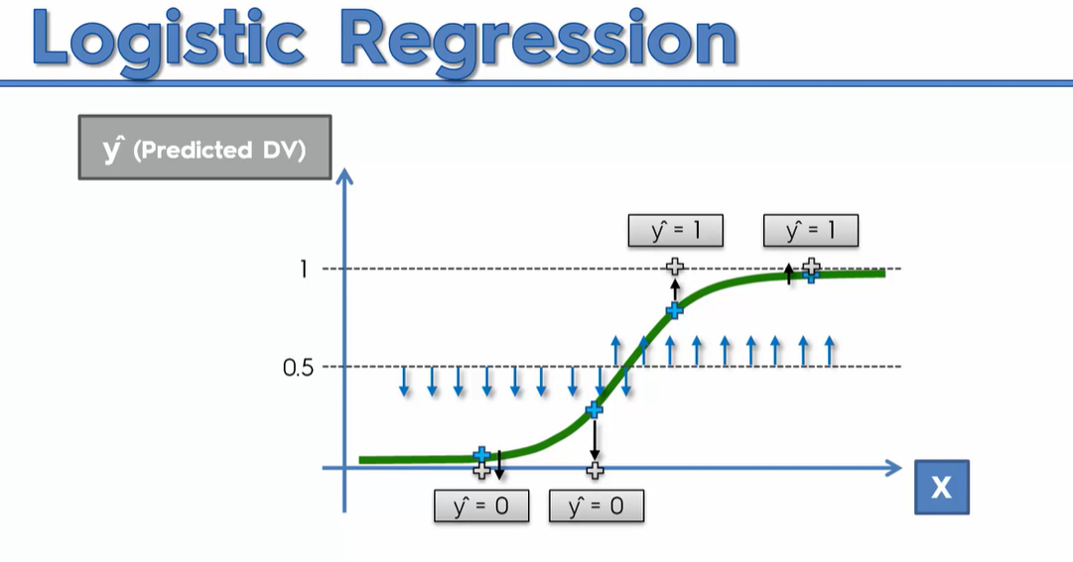

Slide 18
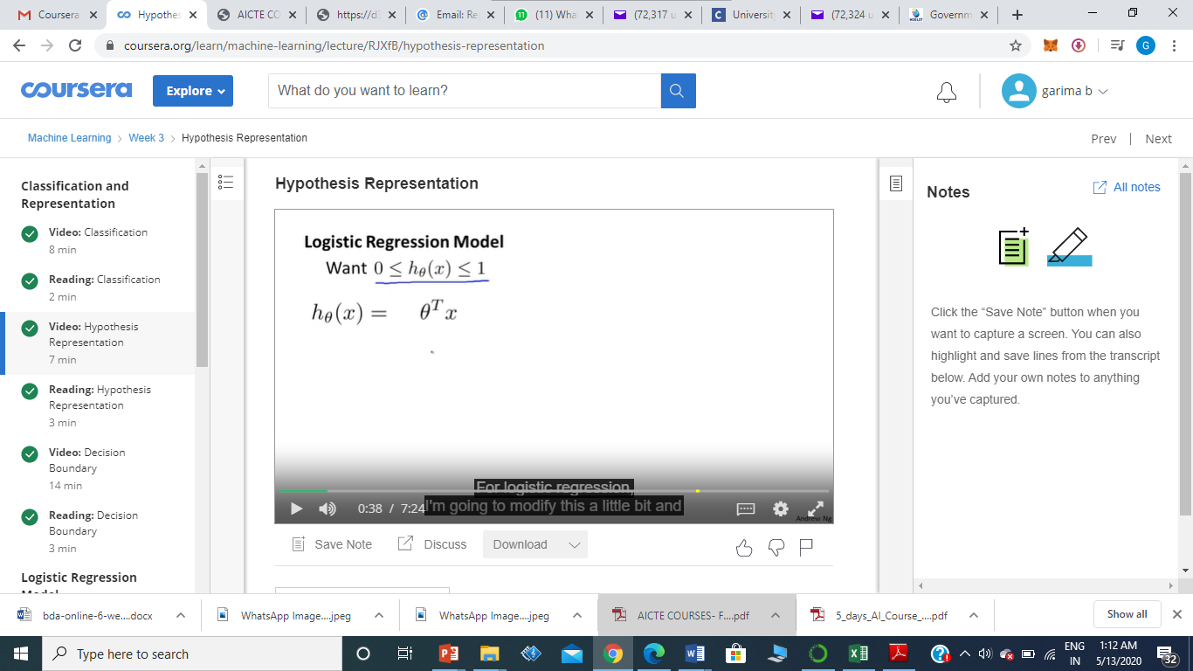
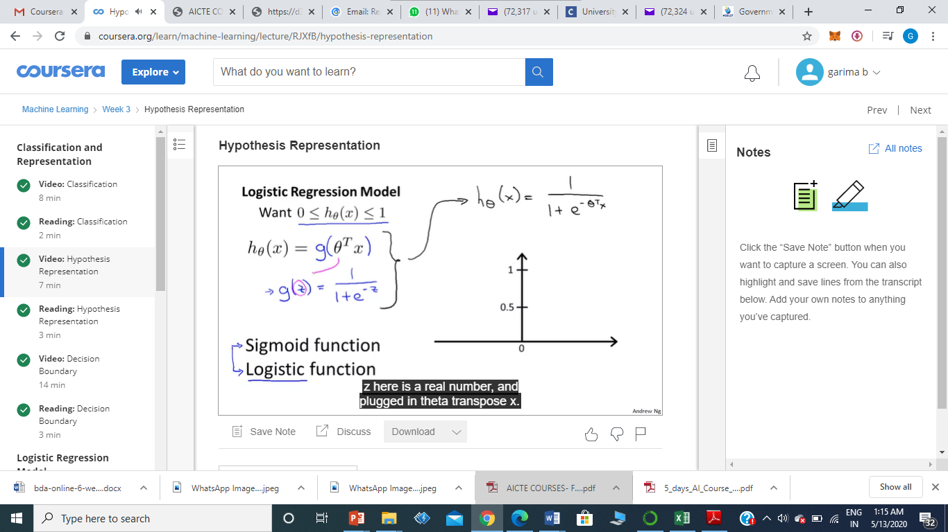
Logistic Function / Sigmoid Function
Form of hypothesis in Logistic Regression is :
Define hypothesis function as sigmoid function, assume theta t x values to be equal to z
Use Linear Function of Theta, pass it thru the sigmoid function and use it for classification function

Slide 19
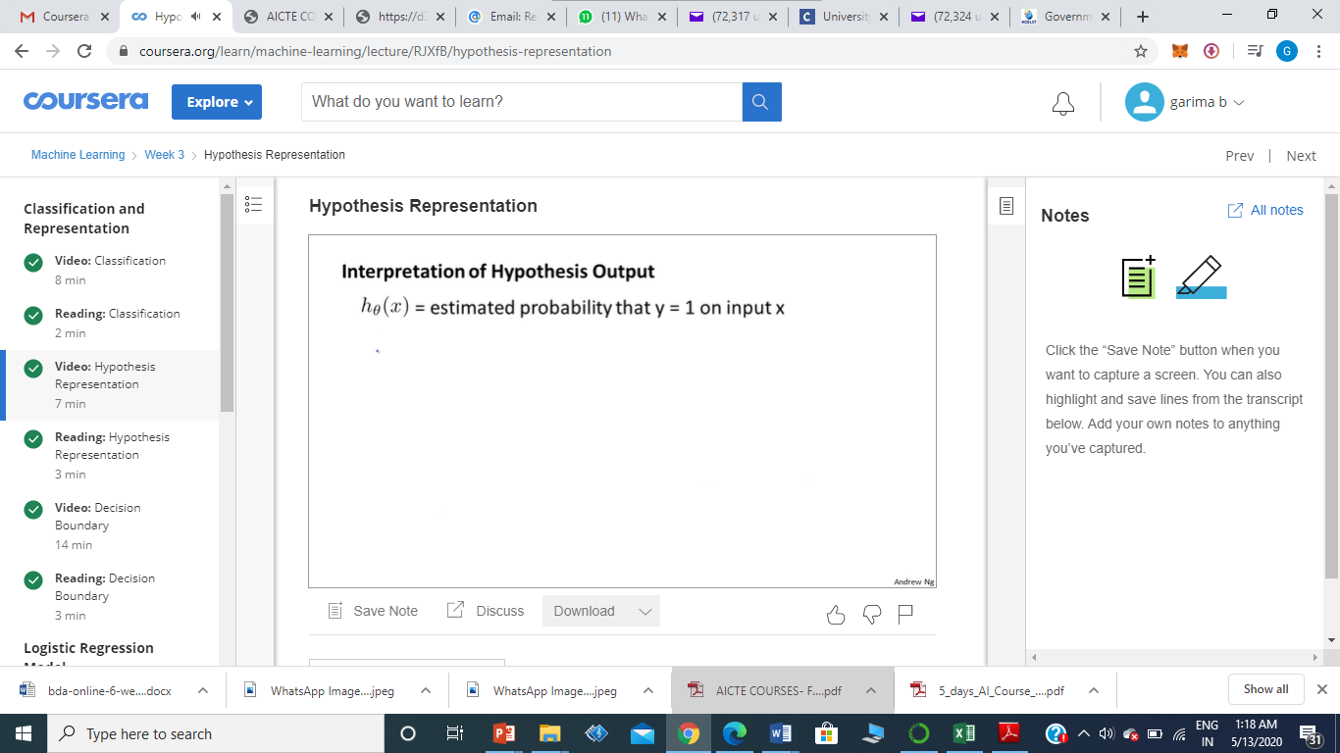
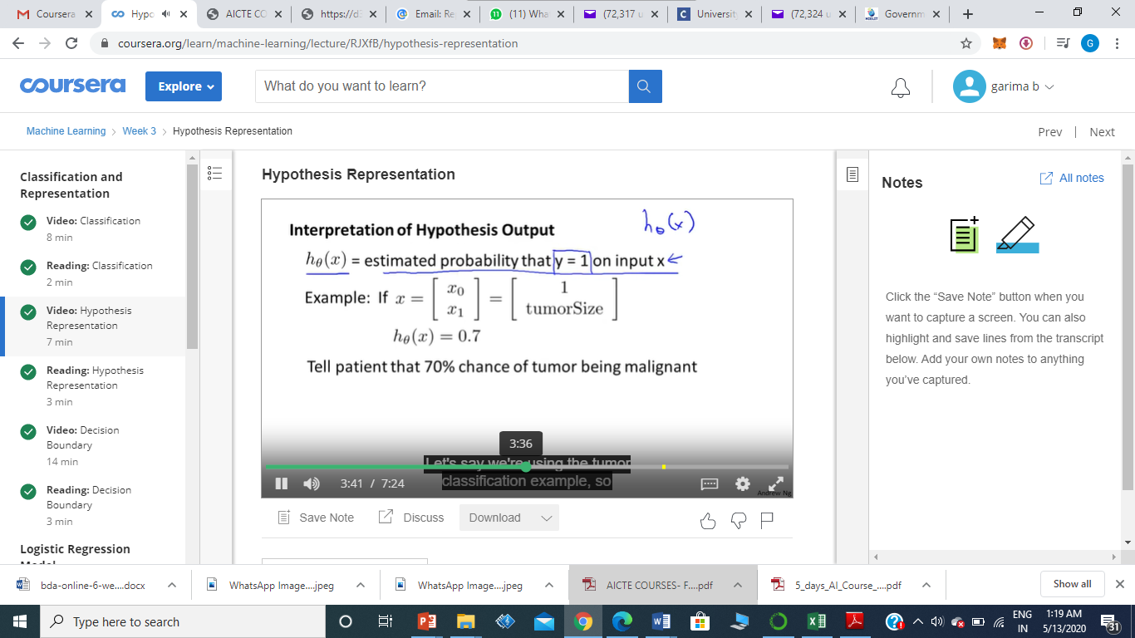
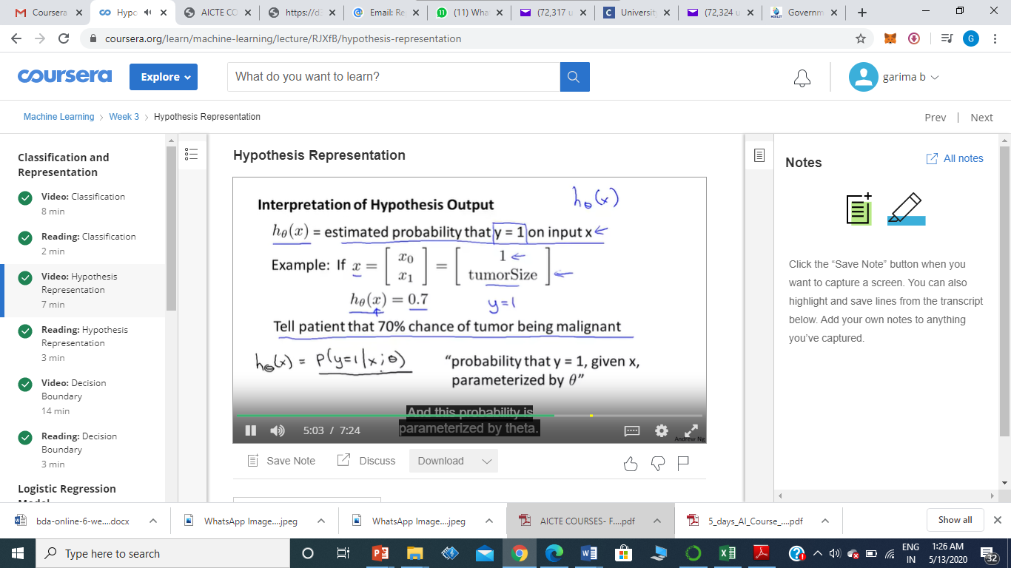
Hypothesis Output
x
For a patient with features x, the probability that y equals 1 is 0.7, ie 70% chance or 0.7 chance of being malignant. Written mathematically as follows:

Slide 20
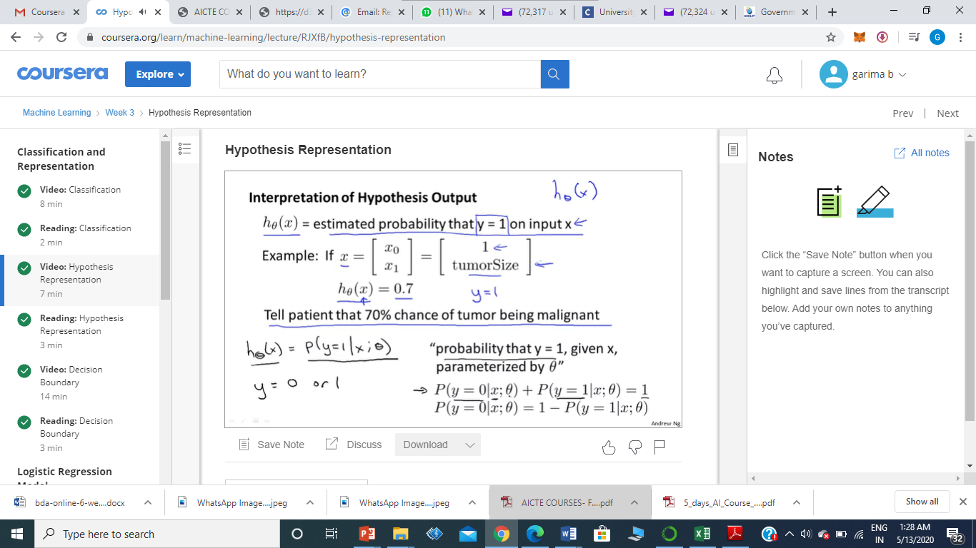
Hypothesis Output
Probabiity of y=0 and probability of y=1 must add upto 1 .

Slide 21
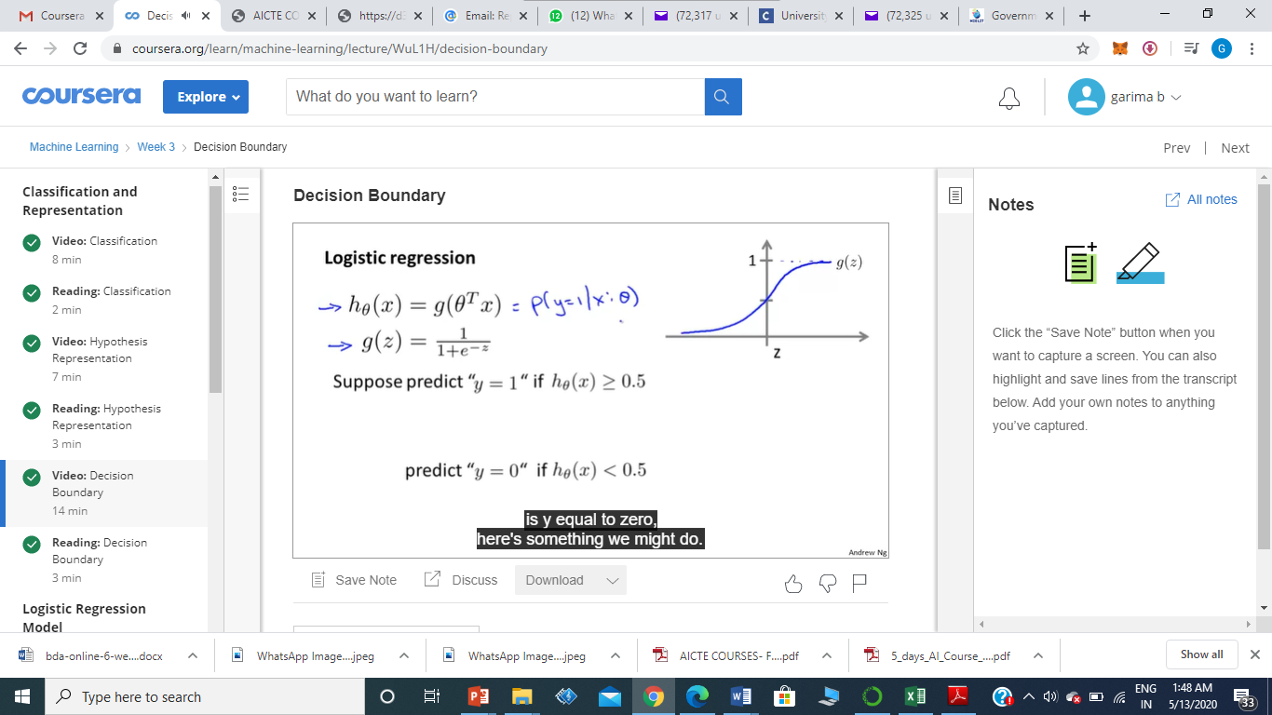
Decision Boundary
Decision Boundary gives an idea of what Regression hypothesis function is computing
Whenever z >= 0 , 1 > g(z) >= 0.5
So when z is positive, g of z , sigmoid function is >= 0.5
Hypothesis will predict y =1 whenever theta transpose x is >=0
Hypothesis will predict y=0 whenever theta transpose x is < 0

Slide 22
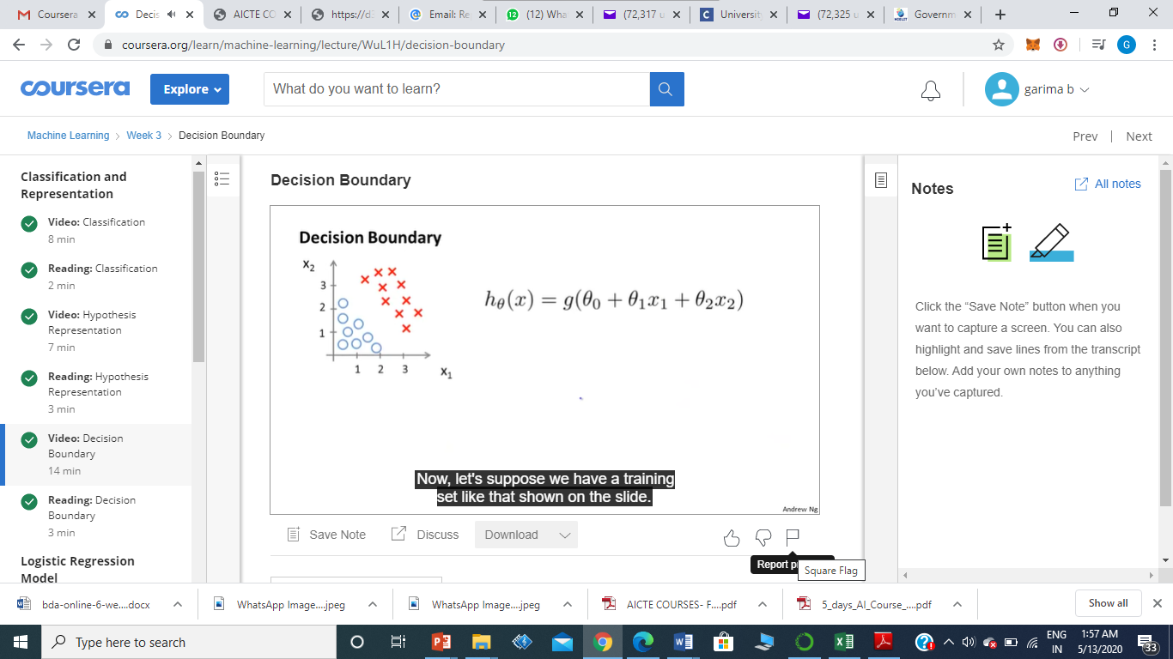
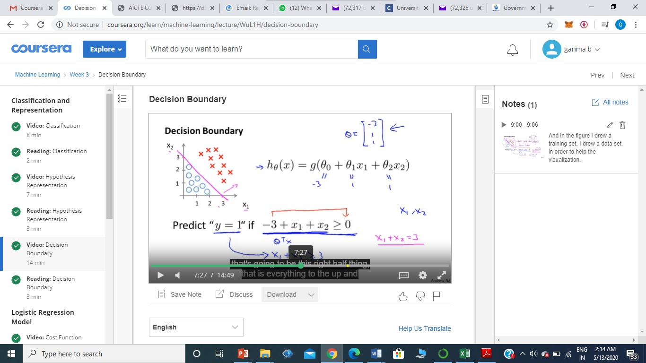
Applying Logistic Regression : Decision Boundary
Choose theta0 = -3, theta1 = 1, theta2 = 1. Therefore parameter vector is theta equals -3, 1, 1.
So for any example, which features x1 and x2 that satisfy this equation, that -3 + x1 + x2 >=0, our
hypothesis will think that y equals 1
We can rewrite x1+x2 >= 3, therefore y=1 whenever x1+x2 >= 3

Slide 23
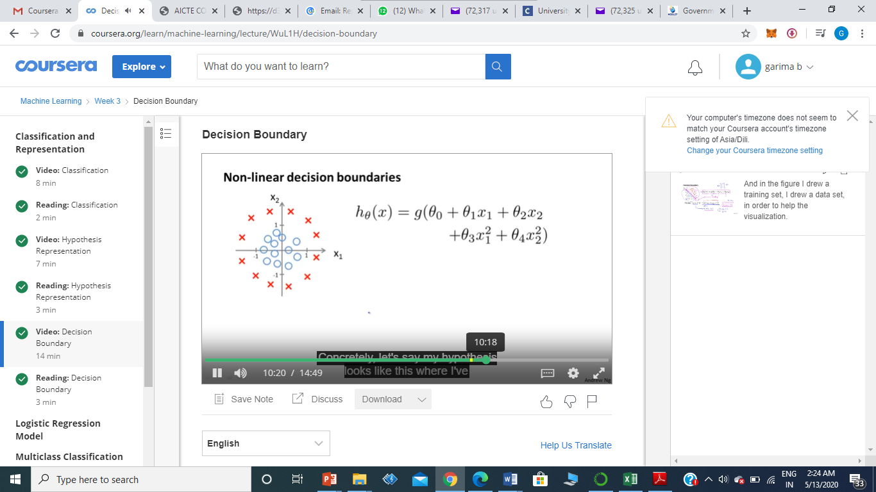
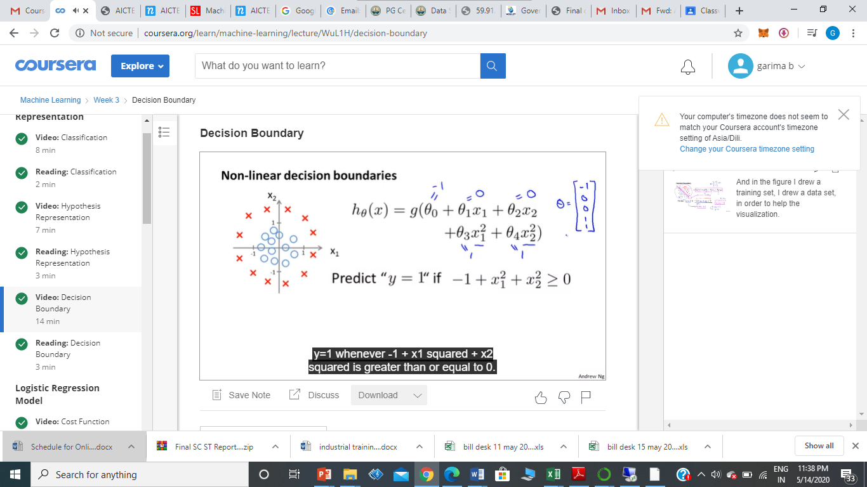
Non Linear Decision boundaries
If Theta0 =-1 and Theta1=0 and Theta2=0 and Theta3=1 and Theta4=1
Hypothesis will predict that y=1 whenever -1 + x1 squared + x2 squared is greater than or equal to 0.

Slide 24
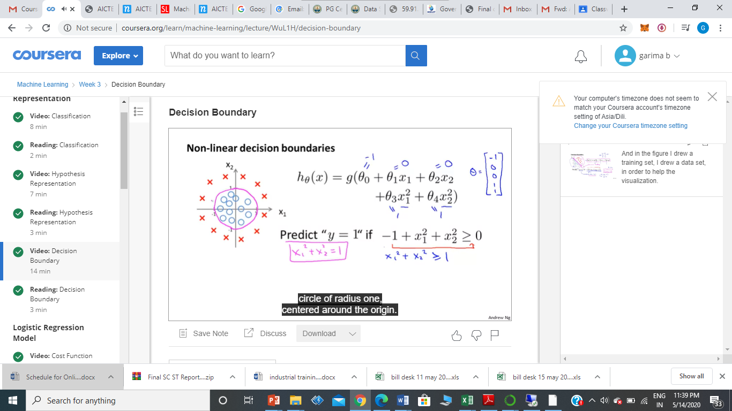
Non Linear Decision boundaries
On plotting the curve for x1 squared plus x2 squared=1 ; x^2 + y^2 = 1
It is the equation for circle of radius one, centered around the origin.
So that is the decision boundary, everything outside the circle is predicted as y=1 everything inside the circle is predicted as y=0.
So by adding these more complex, or these polynomial terms to the features , you get more complex decision boundaries like a circle.

Slide 25
Non Linear Decision boundaries
But the training set is not what we can use to define the decision boundary.
The training set may be used to fit the parameters theta.
Once you have the parameters theta, one can define the decisions boundary.
The training set is just for visualization.

Slide 26
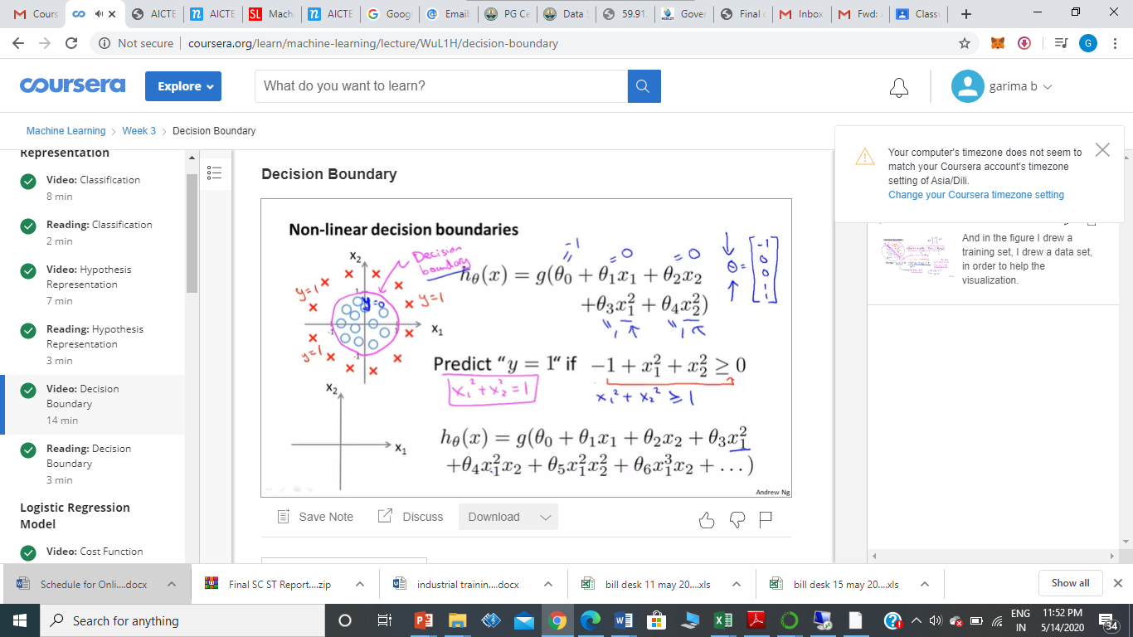
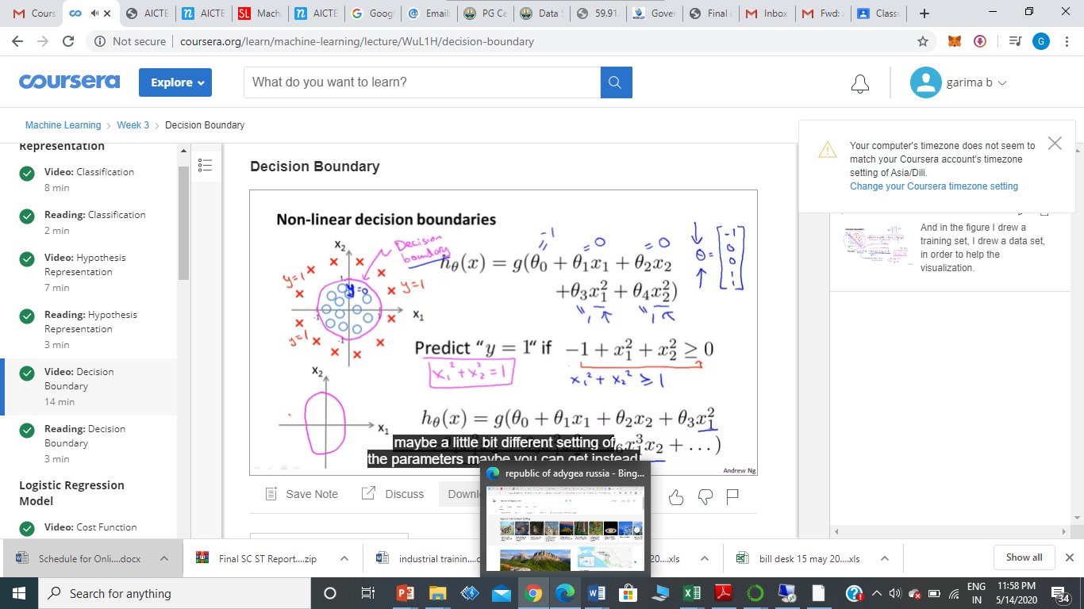
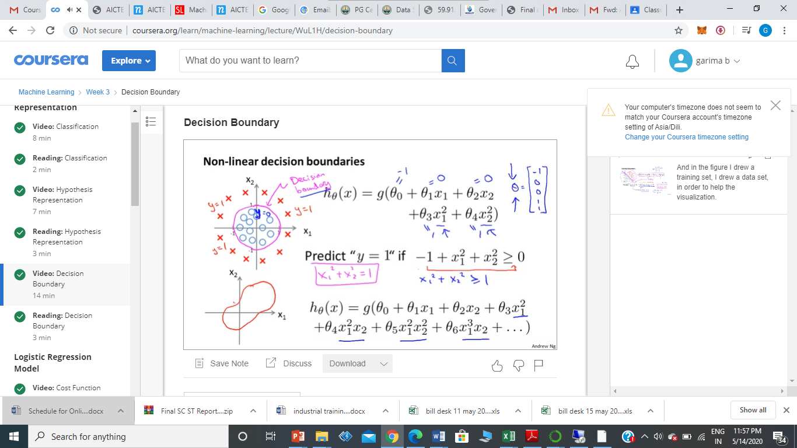
Non Linear Decision boundaries
There can be higher polynomials, then it's possible to show that you can get even more complex decision boundaries and the regression can be used to find decision boundaries that may, for example, be an ellipse.
For even more complete examples maybe you can also get this decision boundaries that could look like more complex shapes.

Slide 27
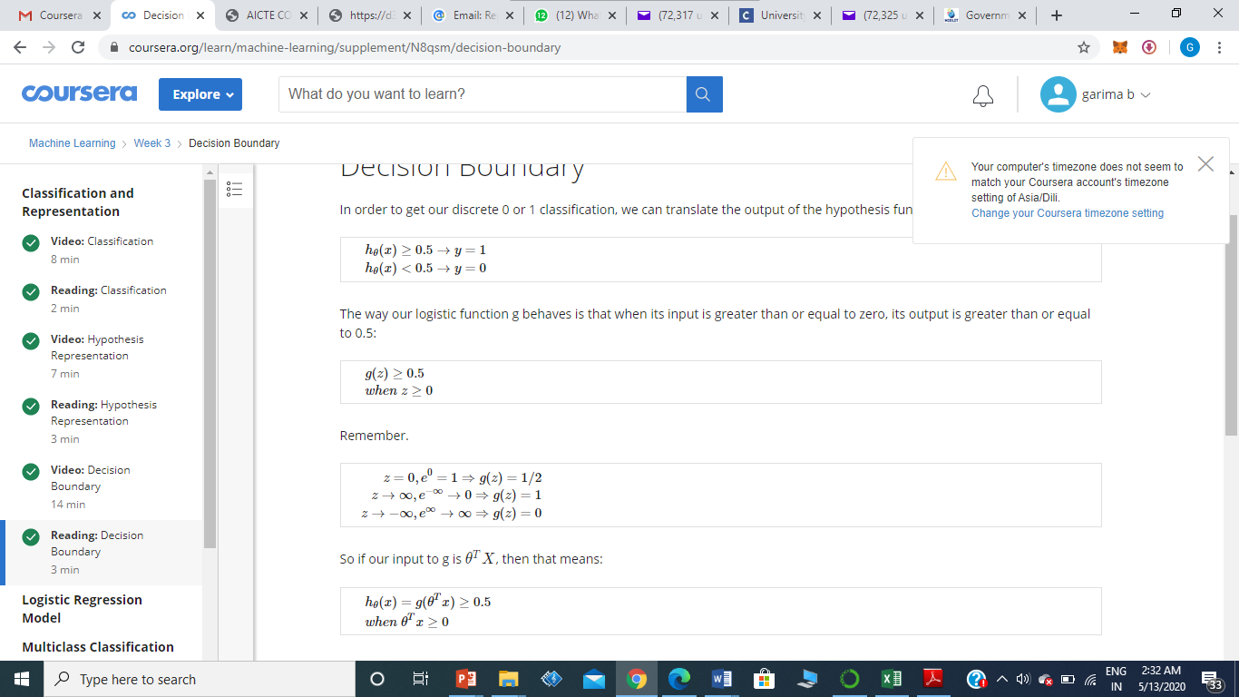
Conclusion : Non Linear Decision boundaries

Slide 28
Conclusion : Non Linear Decision boundaries

Slide 29
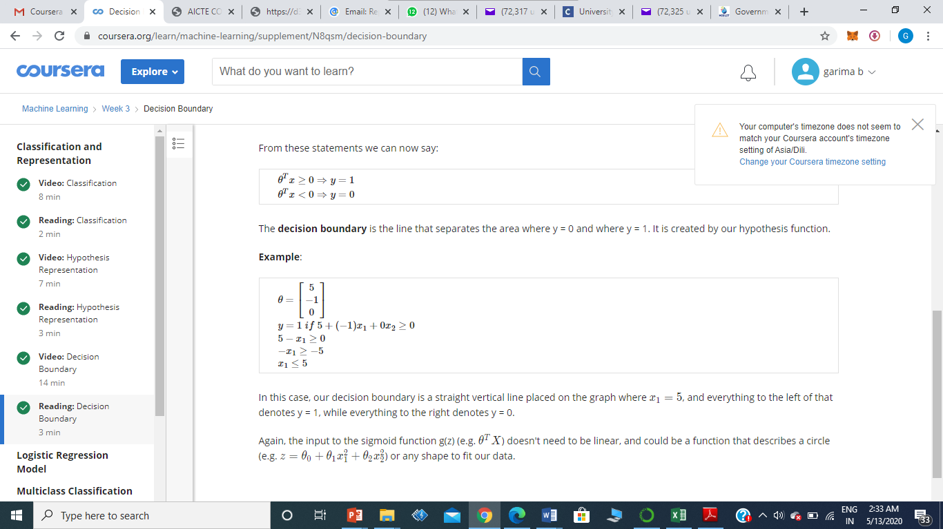
Non Linear Decision boundaries

Slide 30
Cost Function in Logistic Regression
After knowing what is h(x) like, our goal is to automatically choose the parameters Theta, so that given a training set, we can automatically fit the parameters to our data.
We cannot use the same cost function that we use for linear regression because the Logistic Function will cause the output to be wavy, causing many local optima. In other words, it will not be a convex function.

Slide 31
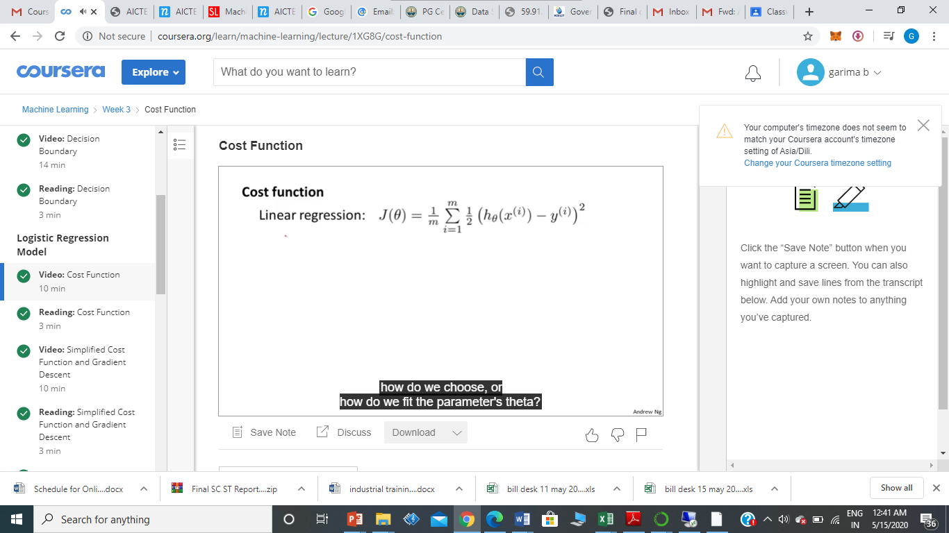
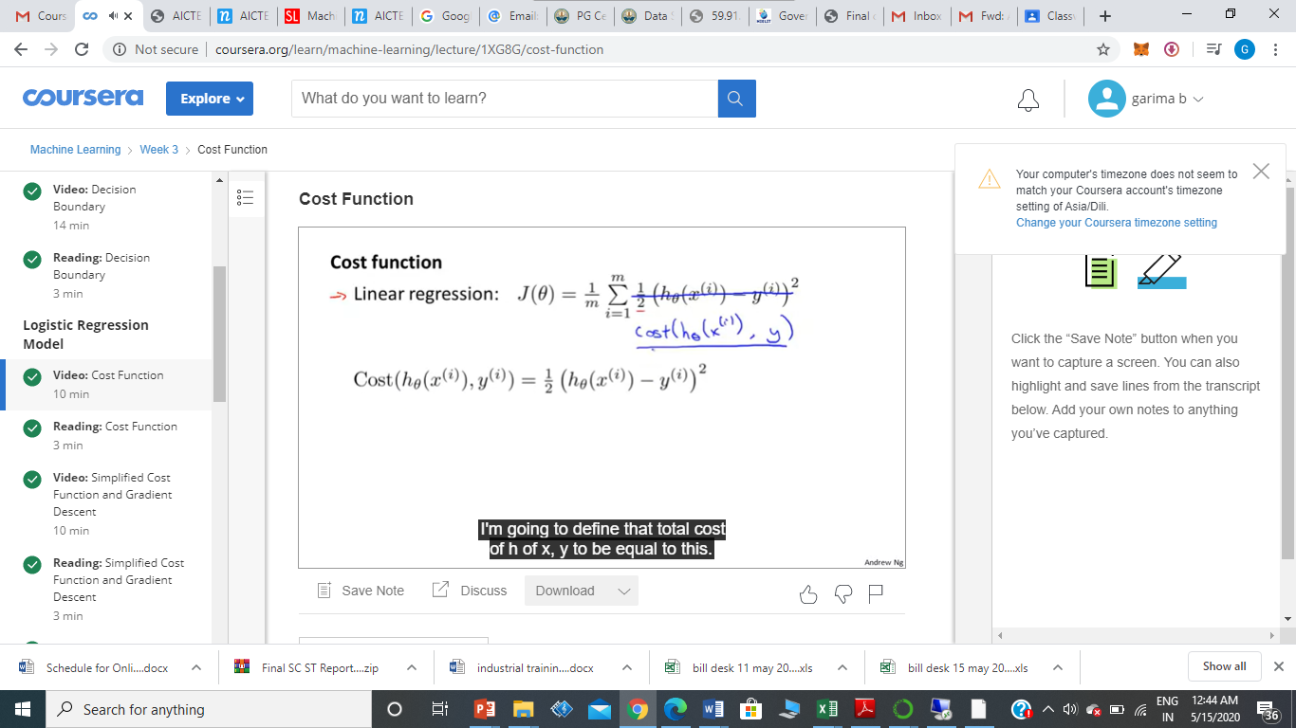
Cost Function in Logistic Regression
Instead of 1/2m, taken slightly differently 1/m outside. We write alternately.
If we use this particular cost function, it would be a non-convex function of the parameters data.

Slide 32
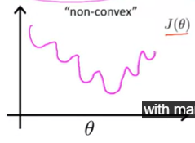
Cost Function in Logistic Regression
Actually the z in g(z) or h(x) has non-linearity
J of Theta will look like
Will have many local minimum, non-convex, on running GD, not guaranteed that it will converge to global minimum

Slide 33
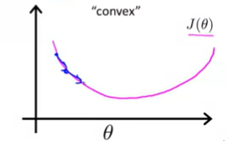
Cost Function in Logistic Regression
In the cost function J of Theta, which is convex, on running GD, it is guaranteed that GD will converge to global function.

Slide 34
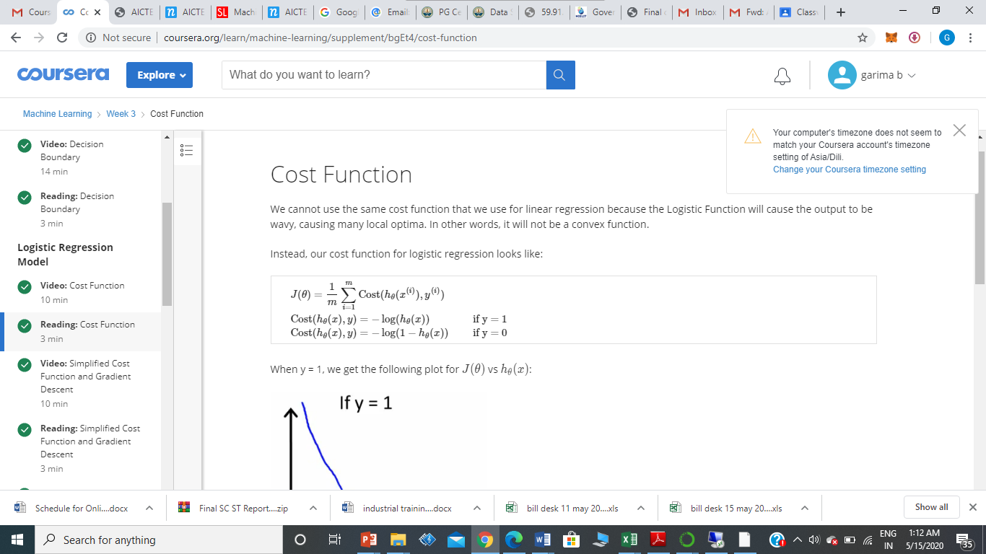
Cost Function for Logistic Regression

Slide 35
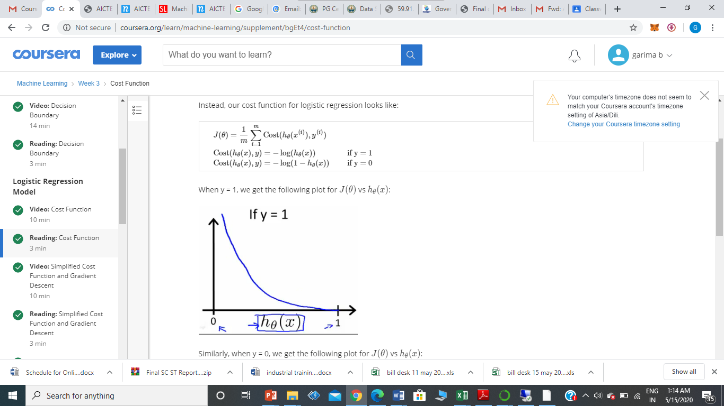

Slide 36
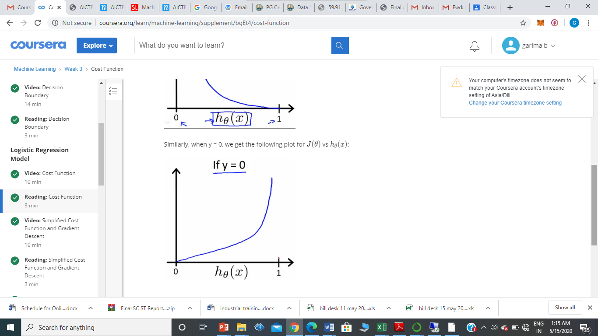

Slide 37
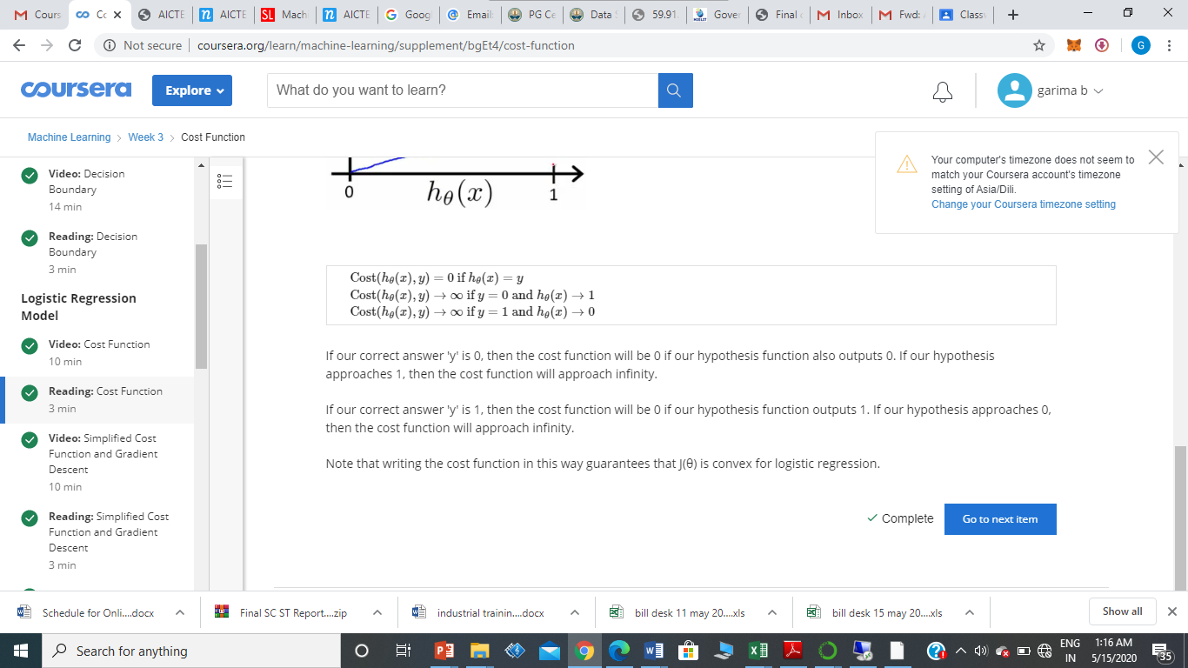

Slide 38
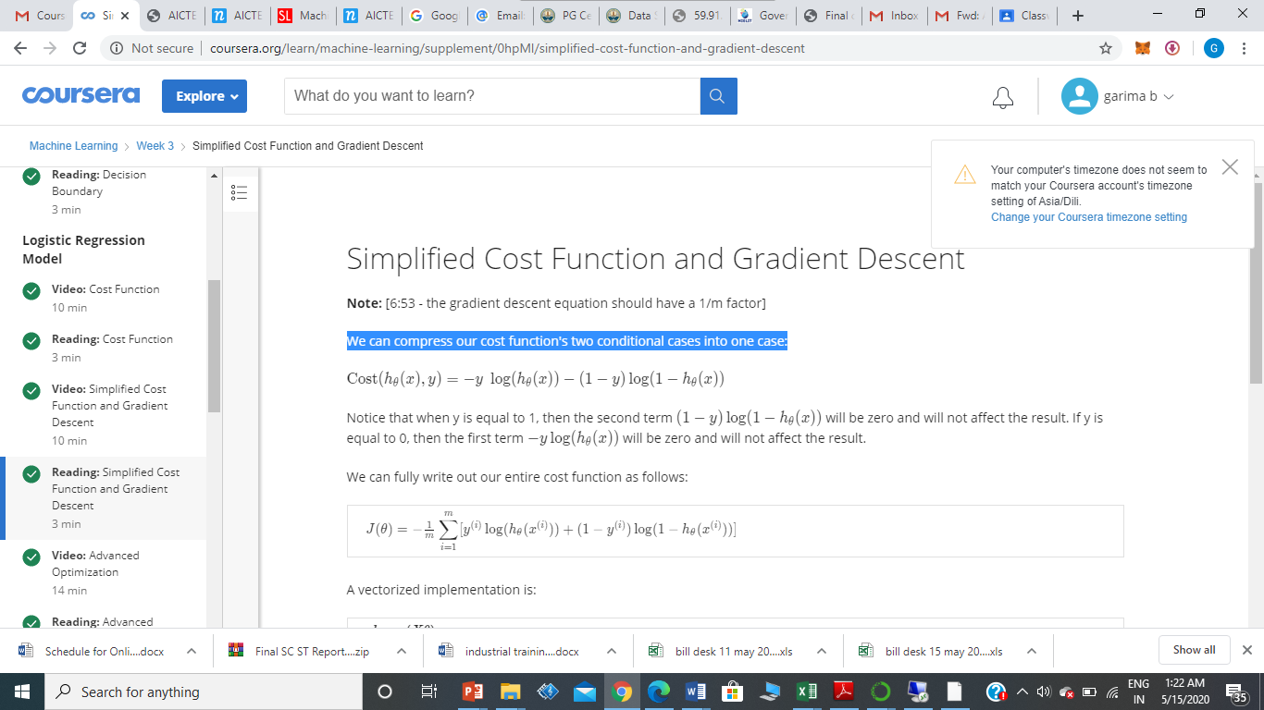
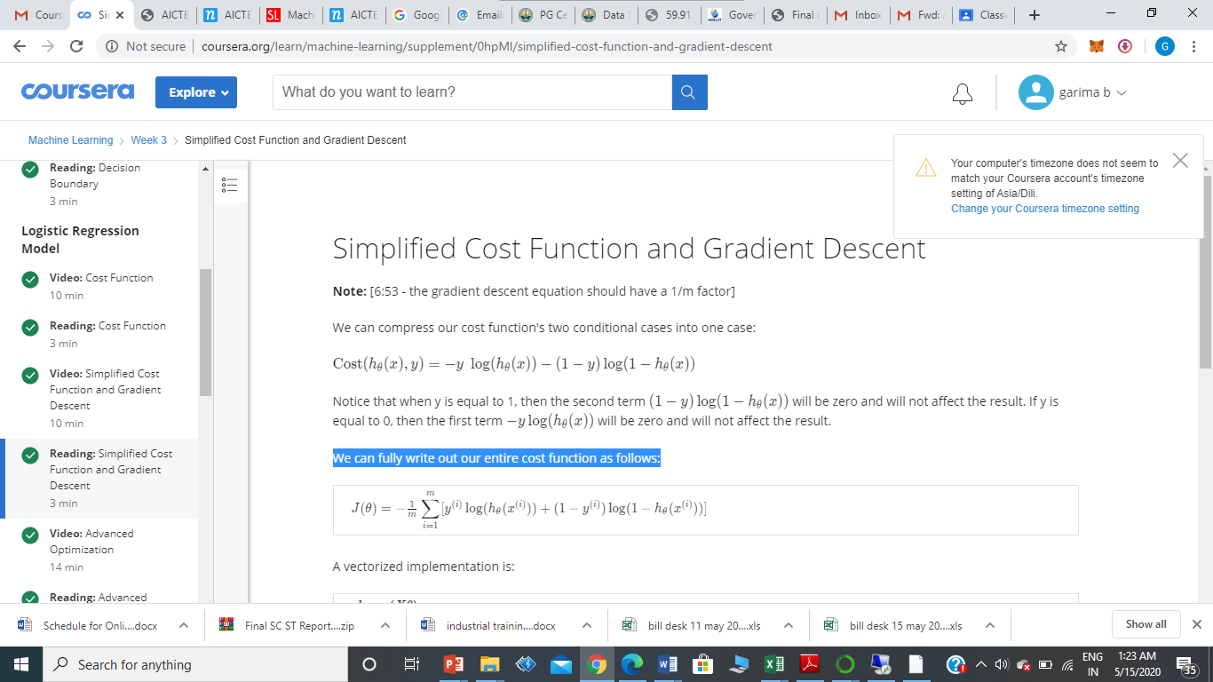
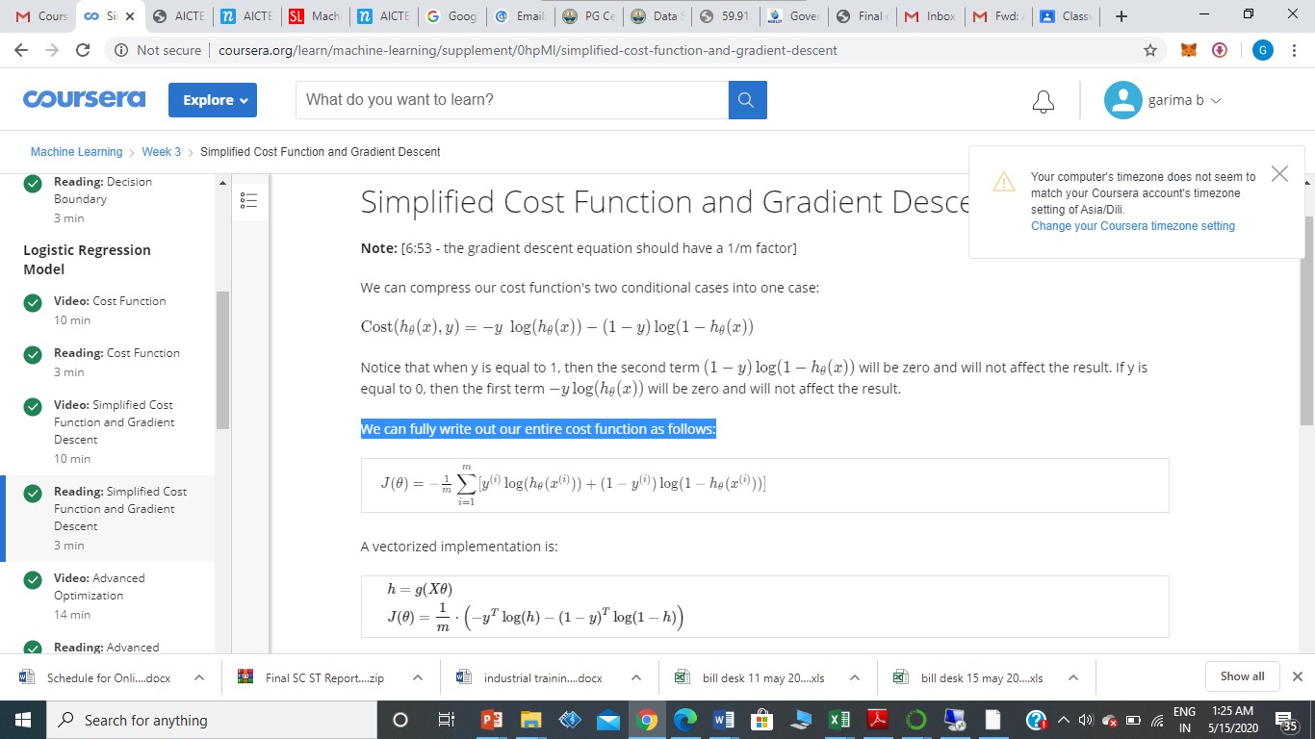
Simplified Cost Function and Gradient Descent
We can compress our cost function's two conditional cases into one case:
We can fully write out our entire cost function as follows:-

Slide 39
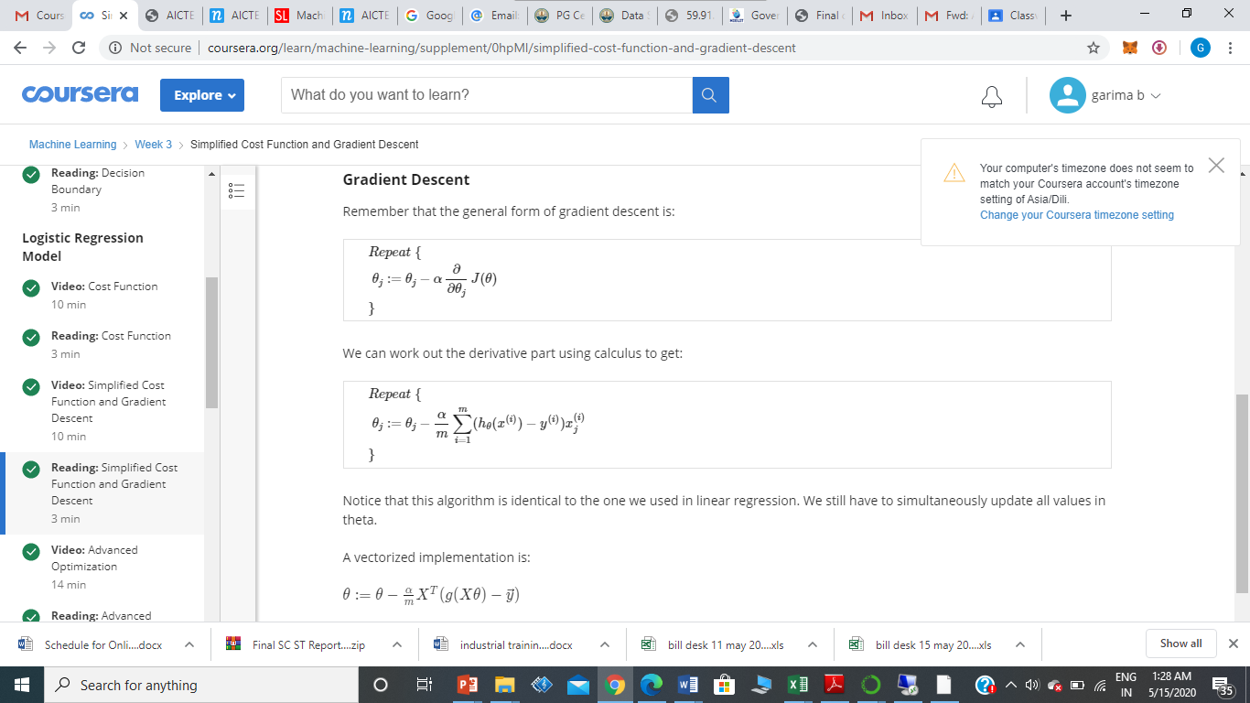
Gradient Descent
Remember that the general form of gradient descent is:

Slide 40
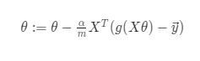
Gradient Descent
Notice that this algorithm is identical to the one we used in linear regression. We still have to simultaneously update all values in theta.
A vectorized implementation is:

Slide 41
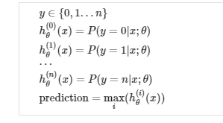
Multi Class Classification : One Vs All
Now we will approach the classification of data when we have more than two categories. Instead of y = {0,1} we will expand our definition so that y = {0,1...n}.
Since y = {0,1...n}, we divide our problem into n+1 (+1 because the index starts at 0) binary classification problems; in each one, we predict the probability that 'y' is a member of one of our classes.

Slide 42
Multi Class Classification
Example:
Want to tag my emails into four groups
Work y=1
Friends y=2
Family y=3
Hobby y=4

Slide 43
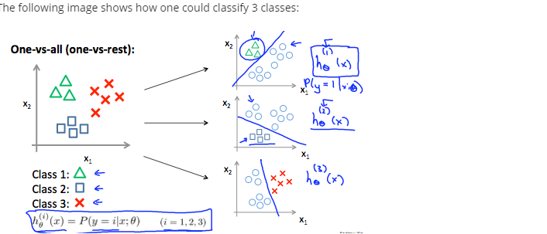
We are basically choosing one class and then lumping all the others into a single second class. We do this repeatedly, applying binary logistic regression to each case, and then use the hypothesis that returned the highest value as our prediction.

Slide 44
Conclusion
Train a logistic regression classifier hTheta(x) for each class to predict the probability.
To make a prediction on a new x, pick the class that maximizes htheta(x).

